Slide 1
Financial Engineering with Python
Miquel Noguer i Alonso PhD

Slide 2


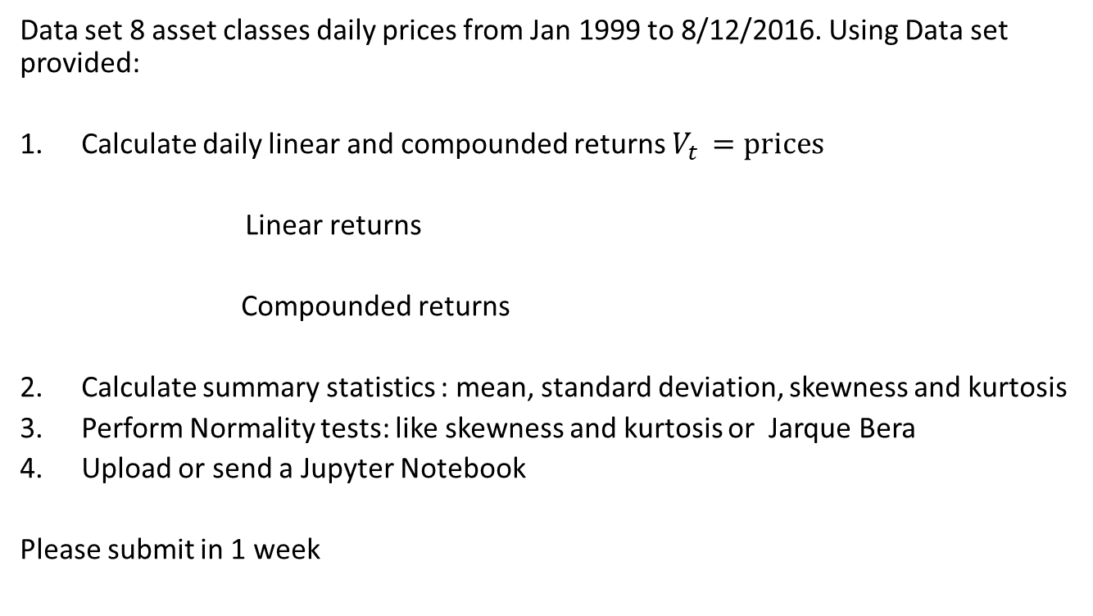
Homework 1
Data set 8 asset classes daily prices from Jan 1999 to 8/12/2016. Using Data set provided:
Calculate daily linear and compounded returns $V_{t }=prices$
Linear returns
Compounded returns
Calculate summary statistics : mean, standard deviation, skewness and kurtosis
Perform Normality tests: like skewness and kurtosis or Jarque Bera
Upload or send a Jupyter Notebook
Please submit in 1 week

